Slide 1
Towards Medical Image Processing
ANKITA MANDAL
SIDDHAANT PRIYAM

Slide 2
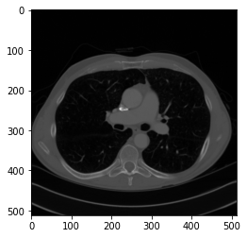
Working with DICOM images
DICOM stands for Digital Imaging and Communications in Medicine.
(It specifies a data interchange protocol, digital image format, and file structure for biomedical images and image-related information)
DICOM images contain a set of slides of images which also contain the meta data along with it.
Hounsfield Units- They are used in CT images. It is a measure of radio-density. HUs can be calculated from the pixel data with a Dicom Image.

Slide 3
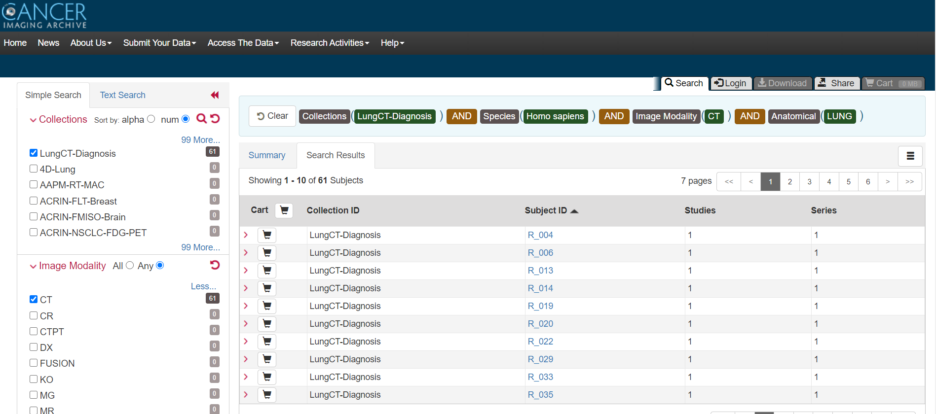
Obtaining the data:
The data was obtained from Cancer Imaging Archive. We obtained the LungCT-Diagnosis collection of data. (https://public.cancerimagingarchive.net/nbia-search/)
After installing NBIA Data Retriever, we extracted the folders of Dicom images of 60 subjects(patients).

Slide 4
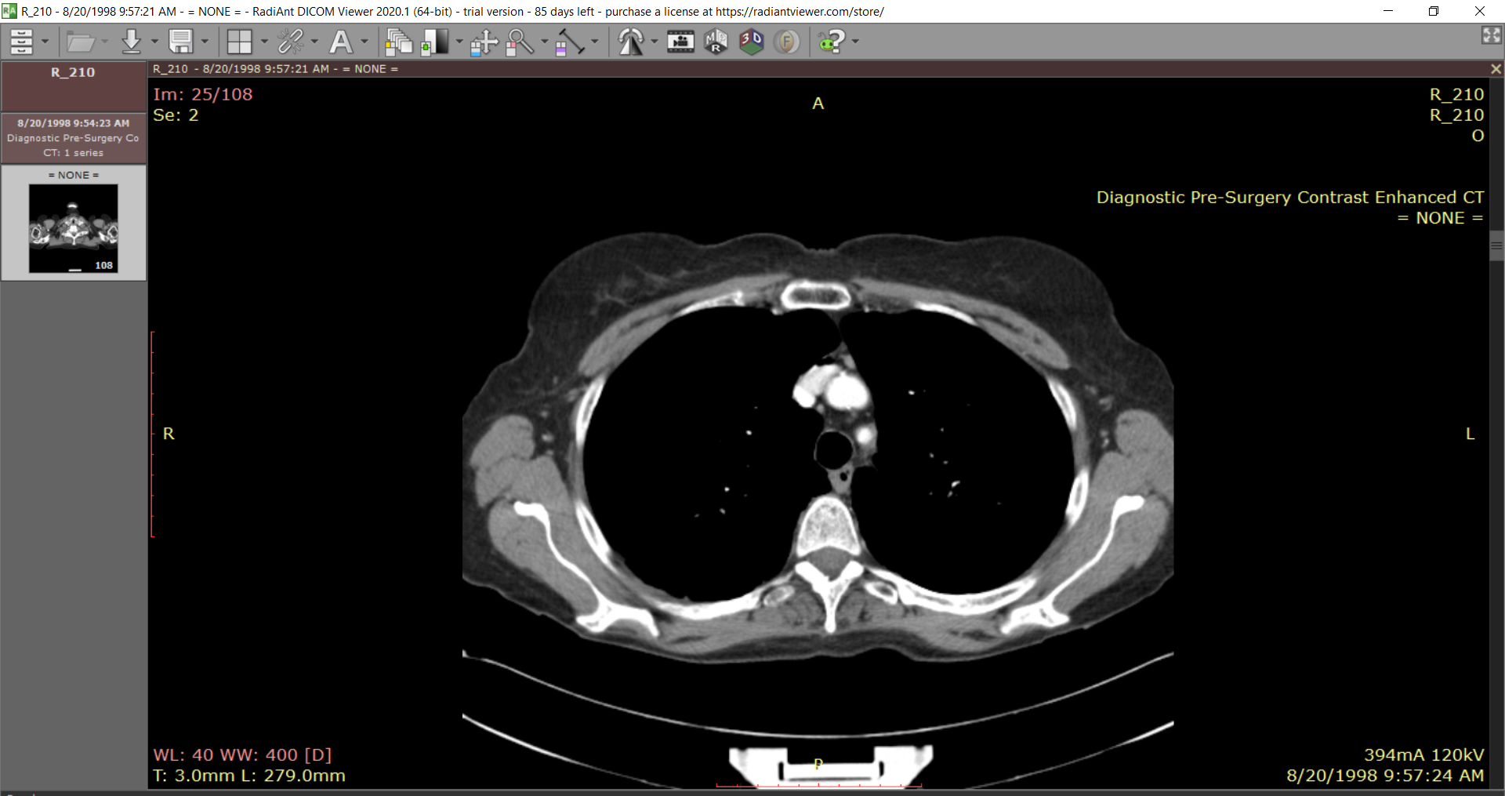
2. Understanding the data
The data consisted of dicom images (.dcm) files enclosed within the folder bearing the patient ids. The data came along with a metadata file and the patients were divided into two classes i.e. ALIVE (1) and DEAD (0). On looking further, we found out that each folder consisted of CT Scan slides of each patient in different orientations. We used applications like QuPath and Radiant DICOM Viewer to view the images.
Radiant DICOM Viewer

Slide 5
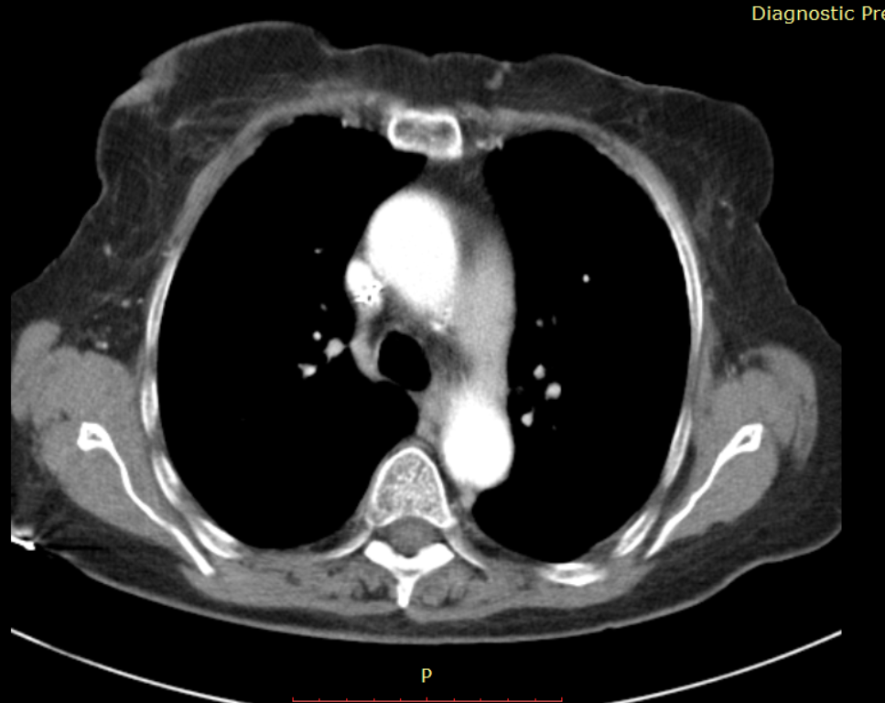
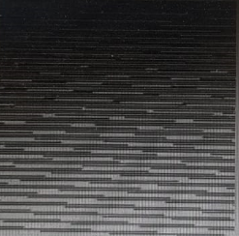
3. Initial Problems
Initial idea was to convert each slide to .jpg format and feeding into the convolutional neural network for classification. But we faced some major problems:
The number of slides in each patient folders were very different and each had different orientation.
We prepared the training images list and training labels manually. So the data that which slide belonged to which patient was lost.
The image quality was lost in conversion to .jpg and on further resizing all the image data was almost lost.
Consequently, many of the convolutional models gave results below average.
Before
After

Slide 6
3. Visualizing the data:
Method to visualize the data in python notebook,
A- Loading the DICOM data
B- From pixels, the image data was converted to HU units.
C- Resampling the data- To make it isomorphic, i.e- the pixels data between images is normalised to remove the variance.
D- 3D plotting of data - To visualize the images
E- Segmentation of the Lungs and some tissue around it

Slide 7
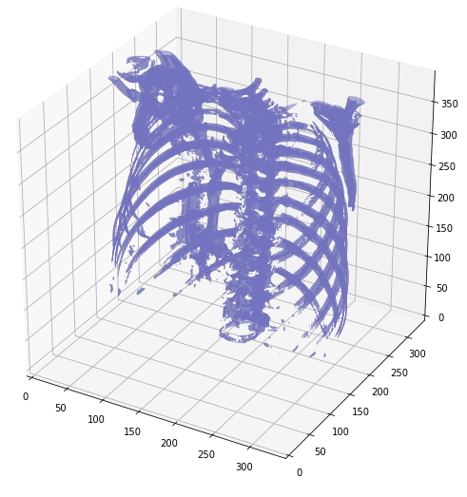
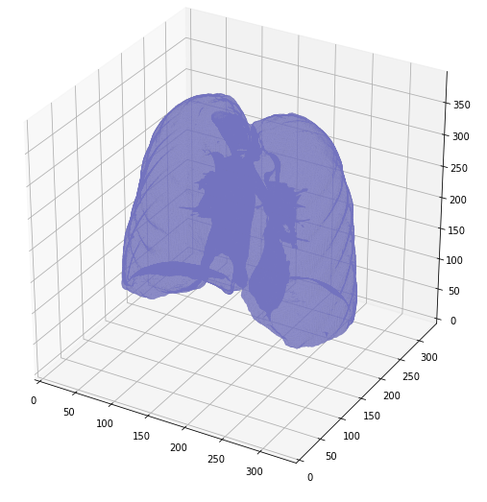

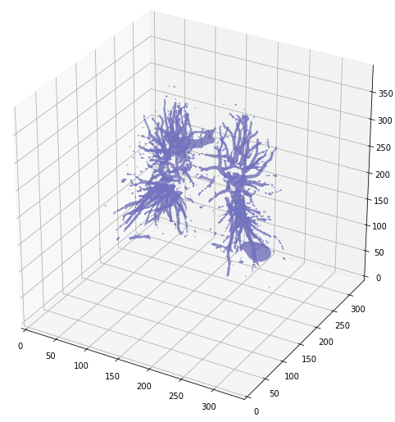
-
3D-plot
Segmented Lungs
Segmented Lung mask

Slide 8
Working on the data
Creating the CSV file:
With the patient data and metadata available, the csv file is made by extracting the survival data as labels for binary classification.
Processing the data:
After resizing the image from 512 x 512 to 150x150, the total number of slices are fixed to 20 for each file from 150-40 scans, which means there was a diverse variability in the number of scans.
Visualising:
Visualised the data, so as to verify the correctness of the features and orientation in the images.
Dividing into train and validation data:
Reshuffled the image data set and picked 50 data to make training data and similarly 10 for the validation data. The image is resized further to 50x50.

Slide 9
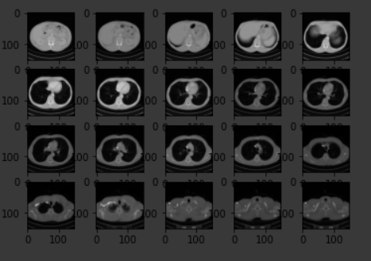
Visualisation
Grayscale image after dividing the data into chunks.
Splitting the data into evenly sized chunks, i.e, chunking the data was necessary since the different patient data had different number of slices, the count varying fr0m 148-34.

Slide 10
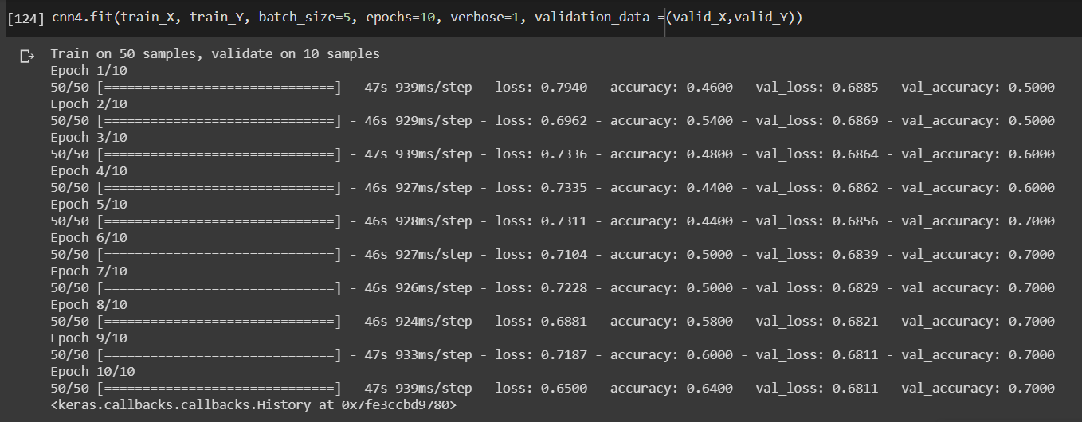
TRAINING THE MODEL
Accuracy obtained in the Conv3d model approach, similar to the VGG-16 model, is 64%.
3D model was required for DICOM images, since an extra dimension is present in this representing the number of slides.

Slide 11
Another Architecture towards improving accuracy
Using another network, the training accuracy reached 92%. The image shaped was changed to 150 x 150 and fed into the architecture. The architecture consisted of the following steps:
3 Conv3D with kernel sizes (3x3x7), (3x3x5) and (3x3x3)
Reshaped the Conv3D output to Conv2D unlike in the previous architecture.
2 Dense layers with dropouts of 0.4
Learning rate of 0.001 and decay rate of 10⁻⁶ (Adam optimiser)

Slide 12
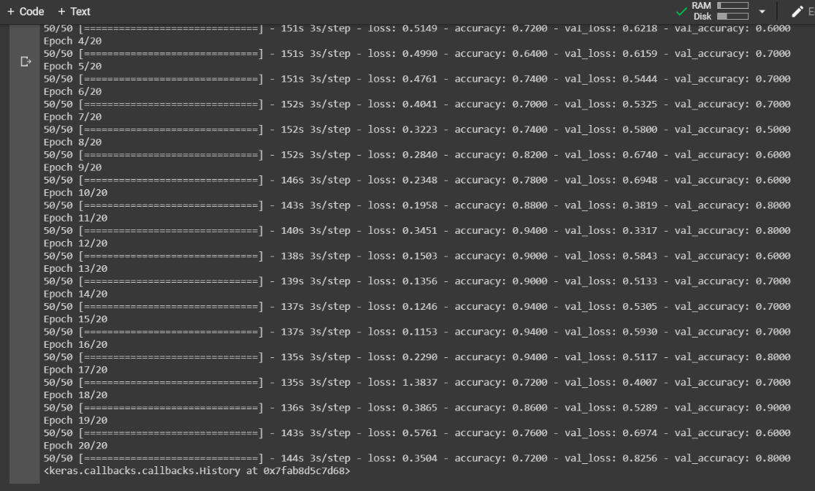
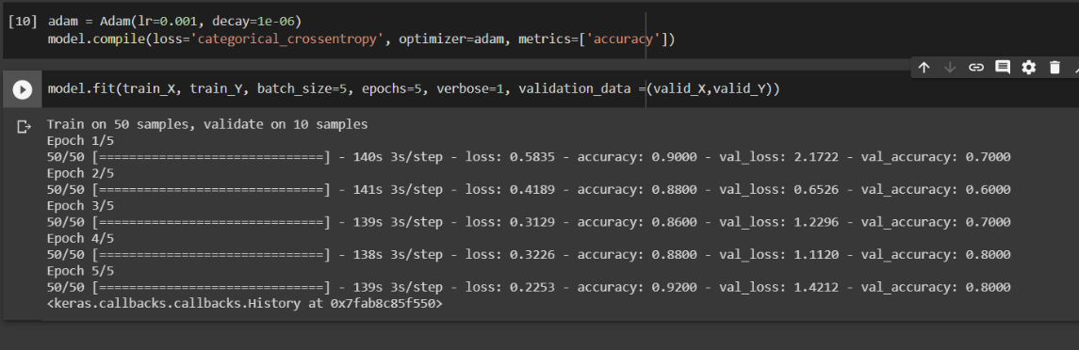
Final Accuracy = 0.92

Slide 13
Thank You

